Slide 1
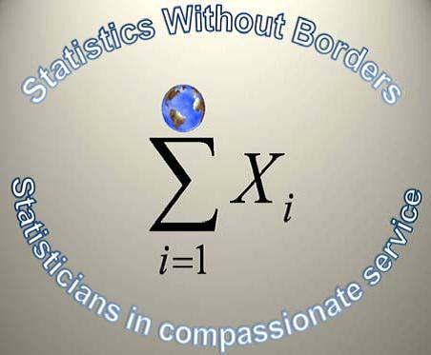
Statistics Without Borders
American Statistical Association
Sampling
Outside the Classroom
University of Houston Clear Lake
December 5, 2012

Slide 2

Presentation Outline
Statistics Without Borders
  Overview
  Expertise
  Project Examples
  Education
Real World Questions
  Crime & Health Data Example
    Population
    Sampling & Weighting
    Comparisons

Slide 3
Statistics Without Borders
Overview
Statistics Without Borders (SWB) is an apolitical Outreach Group of the American Statistical Association (ASA).
Founded in 2008 an international outreach group
Comprised of over 500 volunteers
Provides pro bono statistical consulting to organizations and government agencies (particularly those who are unable to afford statistical help)
Promotes the use of statistics to improve the health and well-being of all people
Entails a vision to achieve and implement the best statistical practice in the service of others

Slide 4
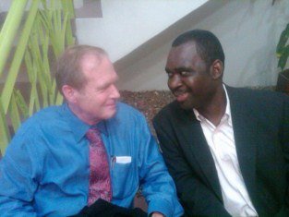
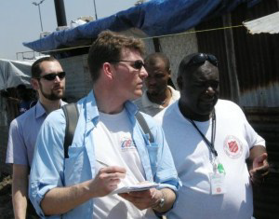
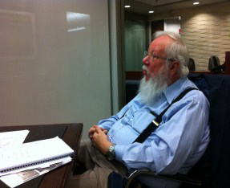
Statistics Without Borders
Expertise
Due to the extensive expertise and experience that our volunteers encompass, Statistics Without Borders can help organizations and agencies with many areas of projects including but not limited to*:
Research and Evaluation Design
Exploratory Data Analysis
Field Work (International & Domestic)
Survey Design and Methodology
Survey and Non-Survey Sampling
Scale Indicators Development
Advanced Data Statistical Analysis
Publications Submission Analysis Review
Program Evaluation and Review
Programming and Databases
Data Collection Tools
Preliminary Research Consulting
Hard to Research Population Analysis
*These are just a sample of how our expert volunteers can help organizations.

Slide 5
Statistics Without Borders
Project Examples
Statistics Without Borders has worked on an extensive list of projects with a variety of organizations, agencies and governments. Due to our extensive list, a few have been listed.
Millennium Villages Project in Rural Africa
SWB is worked on the Millennium Villages Project (www.millenniumvillages.org) with researchers from Columbia University’s Earth Institute. This project was designed to demonstrate how the eight Millennium Development Goals could be met in rural Africa in five to ten years through community led development. SWB worked with Millennium Villages on a random cluster study of health and development interventions involving 60,000 households in 14 African countries.
Earthquake Assistance in Haiti
Following the January 2010 earthquake in Haiti, a team of SWB volunteers and SciMetrika* employees visited Haiti to work on a survey to as-sess the economic impact of the disaster. Our goals were to estimate the change in employment status of the Haitian population and to describe and quantify various aspects of the current housing situation. The survey was cell-phone based and our work was featured on National Public Radio. (http://media.theworld.org/audio/060120109.mp3) *SciMetrika is a health consultancy company based in North Carolina.
AES Language Barriers Disparities in Healthcare
This year, SWB has taken on an extensive project from the ground up of helping AES World Lanuages and Cultures Institute (www.awlci.org) in the development of a research department for health care disparities involving language barriers.
Physicians for Human Rights (PHR)
SWB has begun a collaboration with PHR (www.phyisciansforhumanrights.org) in providing analysis on pre and post surveys taken by healthcare trainers in several countries.
*Due to the vast number of projects SWB collaborates on, only a few are listed.

Slide 6
Statistics Without Borders
Education
Statistics Without Borders understands that while many enter or develop careers, questions will arise as to the best methodology for a particular statistical project.
What is the best way to conduct the analysis? Why?
What additional factors should be considered?
Are there different approaches that can also be taken?
How can the chosen method be justified and reviews?
Review of any methodology as well as analysis to ensure accuracy, consistency and the least bias is critical. Thus, Statistics Without Borders dedicates resources towards education in a variety of forms to aid education in statistics such as:
Online Videos
Podcasts
Presentations
Online courses

Slide 7
Real World Questions
Statistics Without Borders and it’s volunteers routinely receive data from various sources where analysis is needed. Routinely, the data provided is hardly perfect.
In most industries, program evaluations occur to determine if the program requires modifications for continual improvement.
One such example for discussion involves a program people awaiting trial who attend a program that provides information in order to help them understand the process of a trial as well as where to get help with health areas as well as their overall success while on trial.
  Interest Areas:
    Overall Questions for Analysis
    Sampling Methodology (if sampling is needed)
    Comparing Groups - Analysis Required
    Concerns with Data
    Justification for Methodology

Slide 8
Crime & Health Data
Crime & Health Data
Provided: Generic Sample Data File
Purpose: To determine where the program is success and needed improvements to the program.
Population: People awaiting trail during a specified time period.
  This includes those who attended the program as well as those who did not attend the program.
  Critical Questions:
    How can a representative sample (if a sample is needed) be constructed to represent the population in comparing those who attended and those who did not attend the program.
    If sampling is not needed, what is required for comparing these groups?
    What is the justification for the method chosen?
    What methods should be taken to compare those who attended with those who did not attend?
  Concern Areas:
    The Mental Health specialist developed and implemented the program.
    The program was highly dependent on officer involvement
    How can these groups be compared? Can they be compared given the number who attended versus those who did not attend?

Slide 9
Population
Crime & Health Population
Give the data file provided, what should be done to compare these groups:
Sampling & Weighting:
  Should the data be sampled?
    If so, what method of sampling should be used and why?
  Should the data be weighted?
    If so, how should the data be weighted and why?
  Do additional options exist?
    If so, what other options would be recommended?
  What justification should be used if a method is chosen?
Group Comparison:
  Can the groups be compared?
    If so, what is the best methodology for comparing these groups?
  What concerns could arise with the data and comparison?
    If concerns are indicated, how can these be combated?

Slide 10
Outcome
Crime & Health Data Comparison Outcome
What outcome from the data file was found in the following areas:
Sampling & Weighting:
  Should the data include sampling?
  If sampling is the best methodology, how should the data be sampled?
  In addition what type of sampling?
    Stratified Sampling
      Male Age Range Ethnicity %
      Female Age Range Ethnicity %
    Cluster Sampling
      Would Male and Female clusters be appropriate (Are the cluster sizes approximately the same?)
    If you chose one, which would it be and what variables would you use?
    Would any weighting need to be done?
    Does that represent the population?
Group Comparison:
  After reviewing sampling, what techniques for comparing groups would you use? Why would you use this technique?

Slide 11
Real World Lessons
Real World Data Analysis
From reviewing this generic data file, questions and concerns, what can be drawn upon when starting or furthering careers in statistics?
No data set in any industry is perfect
Sampling is a critical area in statistics
Justification of methodology is vital
Working with a team can provide valuable insight
Getting a variety of perspectives and peer reviews are required
Client Aspect
From our example, clients want answers to vital questions in their industry
  Program successes
  Program improvements & where they are needed
Expect accuracy of results and methodology
Expertise of statistical methods and how that fits their industry

Slide 12
Thank You!
Got Questions?
Thank You!
Thank you to University of Houston Clear Lake and it’s students
for reviewing a real world example!
Special thank you to Dr. Chhikara!
Mary McGraw Gross, M.S. Statistics & Cynthia McMurray, M.S. Public Administration
Statistics Without Borders
American Statistical Association
www.statisticswithoutborders.com
mary.mcgrawgross@statisticswithoutborders.com

